Slide 1


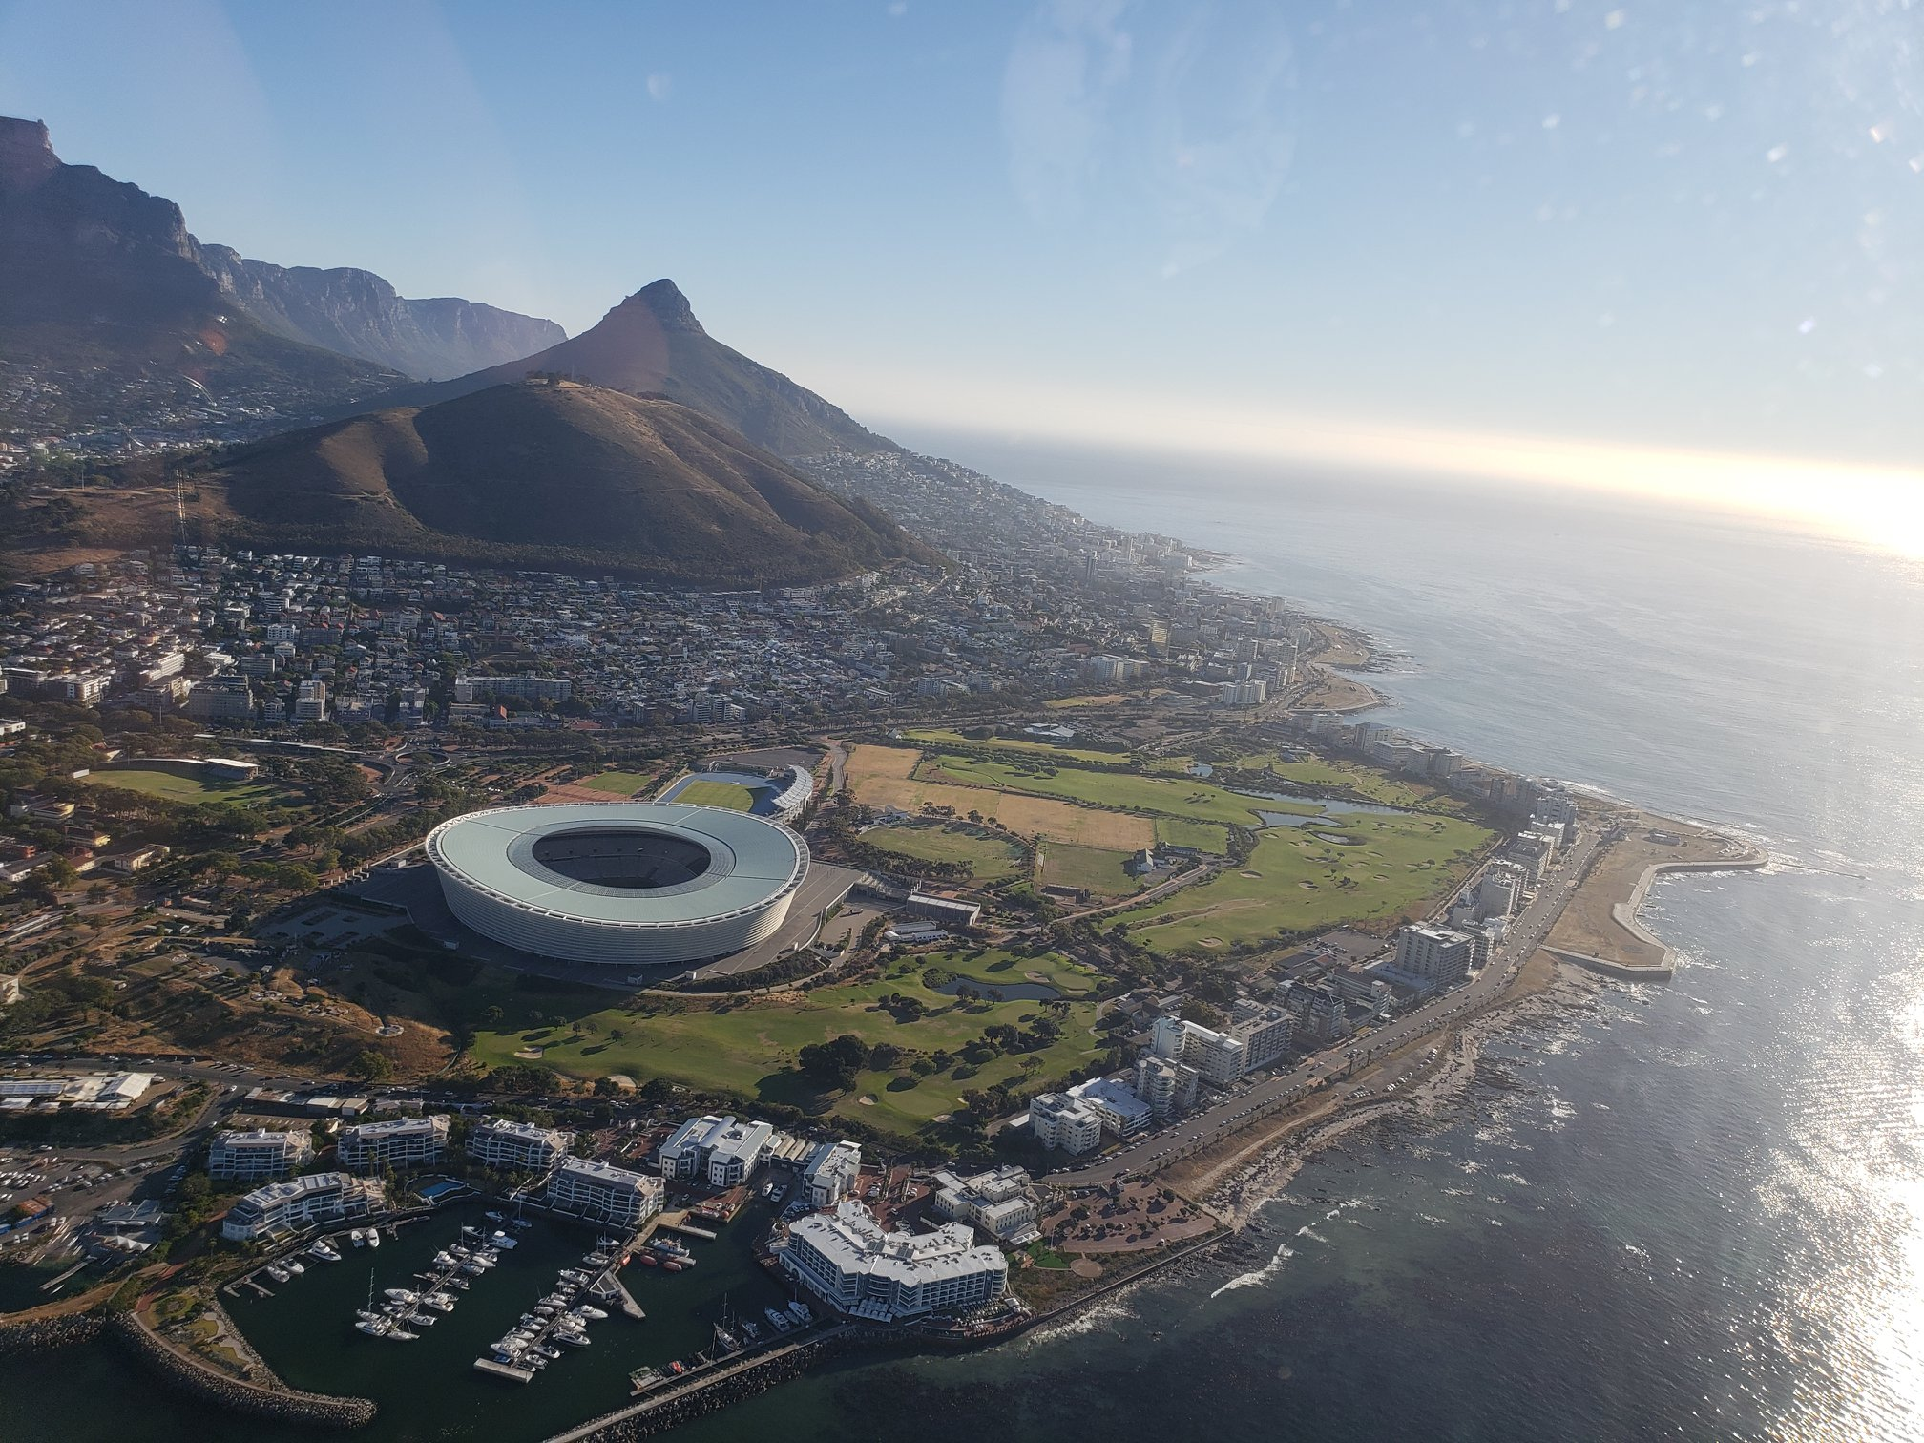




AFIRM: ACM SIGIR/SIGKDD Africa Summer School on Machine Learning for Data Mining and Search Learning to Rank with Neural Networks
Instructors
Bhaskar Mitra, Microsoft & University College London, Canada
Nick Craswell, Microsoft, USA
Emine Yilmaz, University College London
Daniel Campos, Microsoft, USA
January 2020

Slide 2






The Instructors
Bhaskar Mitra
Nick Craswell
Emine Yilmaz
Daniel Campos
Microsoft & UCL, Canada
bmitra@microsoft.com
@underdoggeek
Microsoft, USA
nickcr@microsoft.com
@nick_craswell
UCL & Microsoft, Canada
emine.yilmaz@ucl.ac.uk
@xxEmineYilmazxx
Microsoft, USA
dacamp@microsoft.com
@spacemanidol

Slide 3

Download the slides:
http://bit.ly/ltr-nn-afirm2020
Download the free book:
http://bit.ly/neuralir-intro
Download the lab exercises:
https://github.com/spacemanidol/AFIRMDeepLearning2020
Download TREC Deep Learning Track data:
https://microsoft.github.io/TREC-2019-Deep-Learning/
RESOURCES

Slide 4



Agenda

Slide 5
neural networks
45 mins

Slide 6
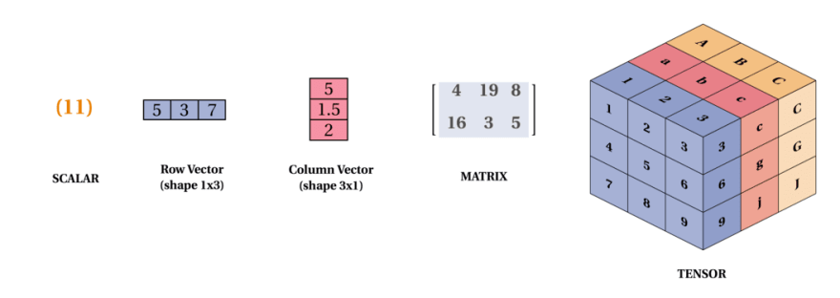
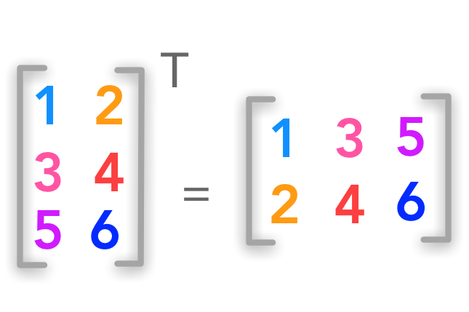
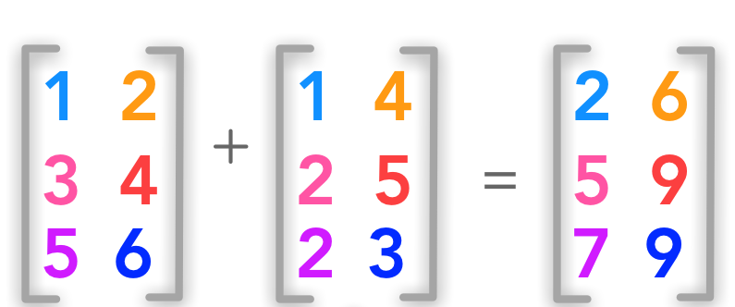
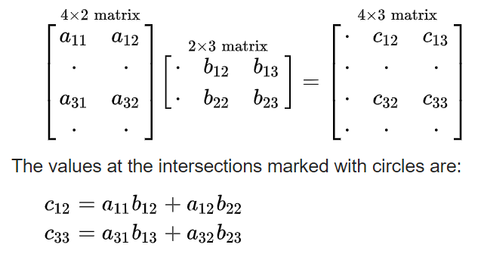
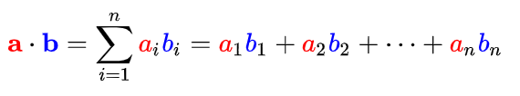
Vectors, matrices, and tensors
matrix transpose
matrix addition
dot product
matrix multiplication
Image source: https://dev.to/mmithrakumar/scalars-vectors-matrices-and-tensors-with-tensorflow-2-0-1f66
Image source: https://hadrienj.github.io/posts/Deep-Learning-Book-Series-2.1-Scalars-Vectors-Matrices-and-Tensors/

Slide 7
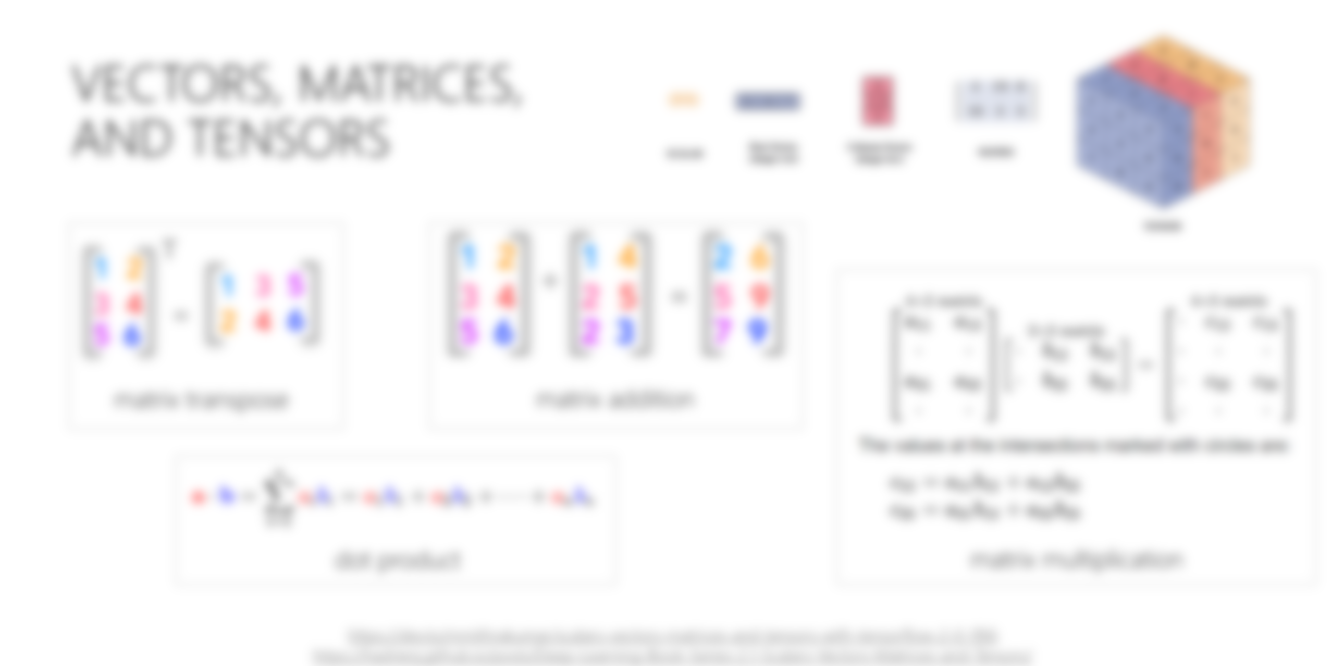
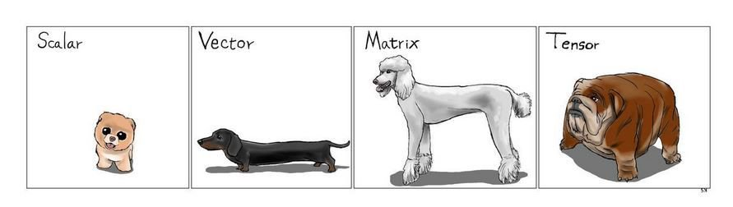

Slide 8
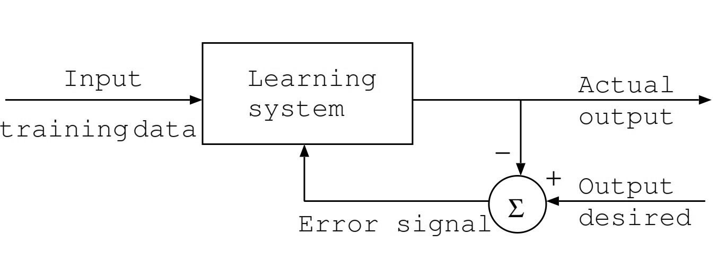
Supervised learning
Image source: https://www.intechopen.com/books/artificial-neural-networks-architectures-and-applications/applying-artificial-neural-network-hadron-hadron-collisions-at-lhc

Slide 9
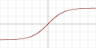
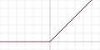
neural networks
Expected output
loss
Predicted output
A simple neural network transforms an input feature vector to produce an output vector by applying sequence of parameterized linear transforms (e.g., matrix multiply with weights, add bias vector) and element-wise non-linear transforms (e.g., tanh, relu)
The parameters are trained using gradient descent to minimize some loss function specified over predicted and expected outputs
Many choices of architecture and hyper-parameters
Non-linearity
Linear transform
forward pass
backward pass
Tanh
ReLU
Non-linearity
Linear transform
Input

Slide 10
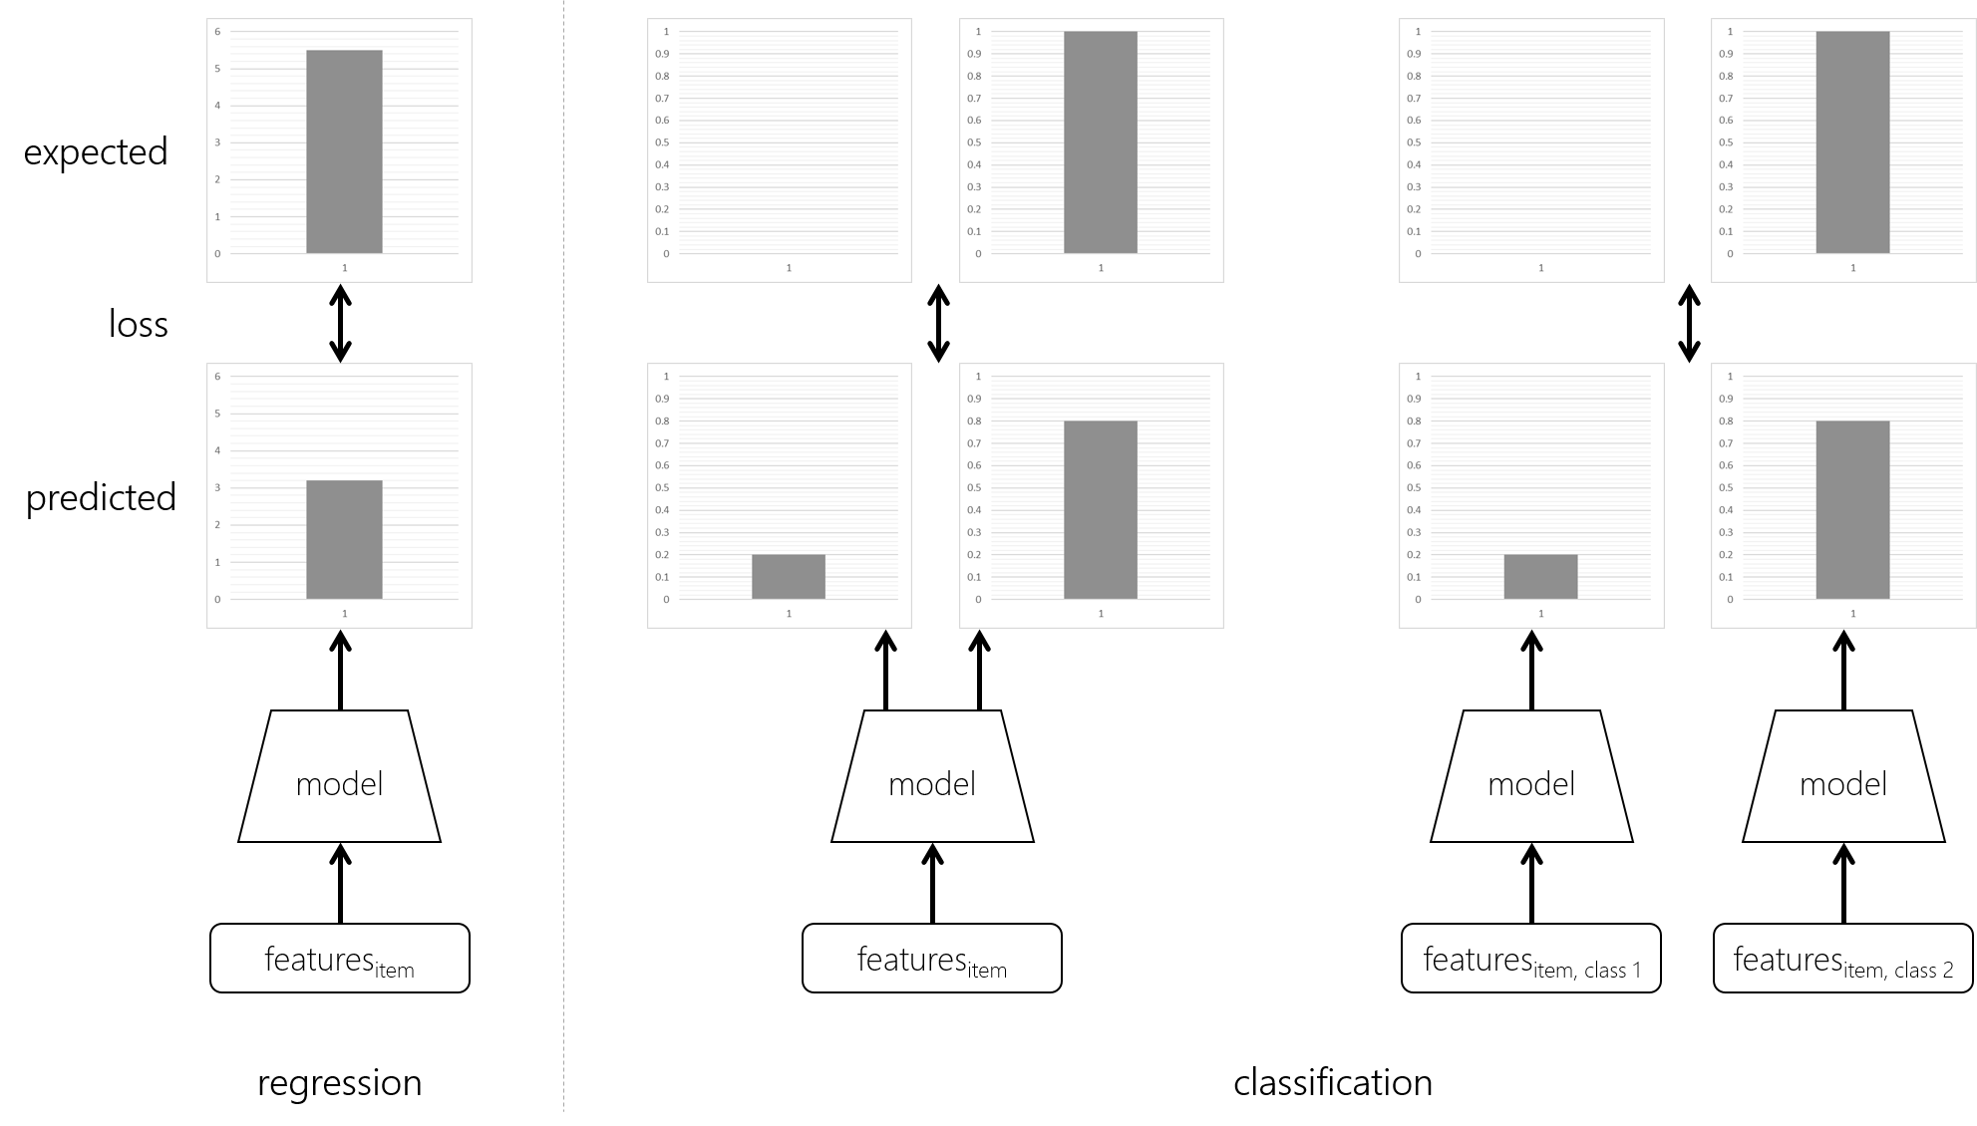
Fundamental machine learning tasks

Slide 11
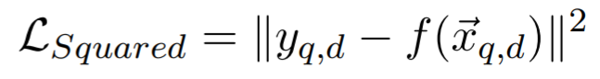
Squared loss
The squared loss is a popular loss function for regression tasks

Slide 12
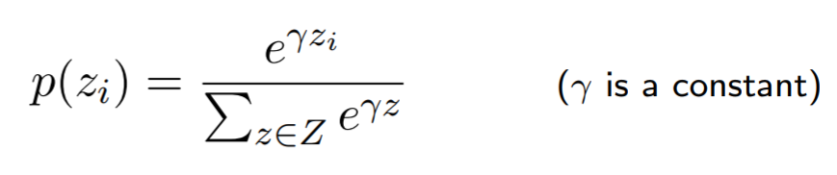
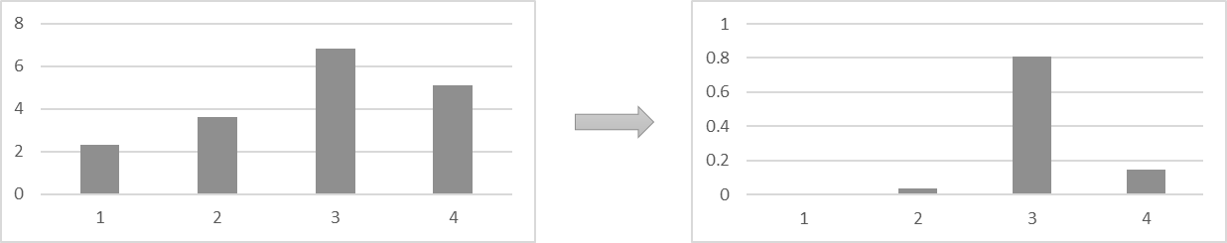
The softmax function
In neural classification models, the softmax function is popularly used to normalize the neural network output scores across all the classes

Slide 13
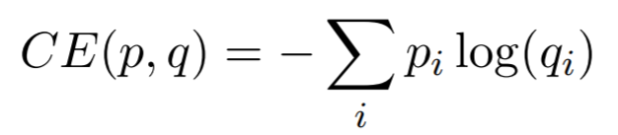
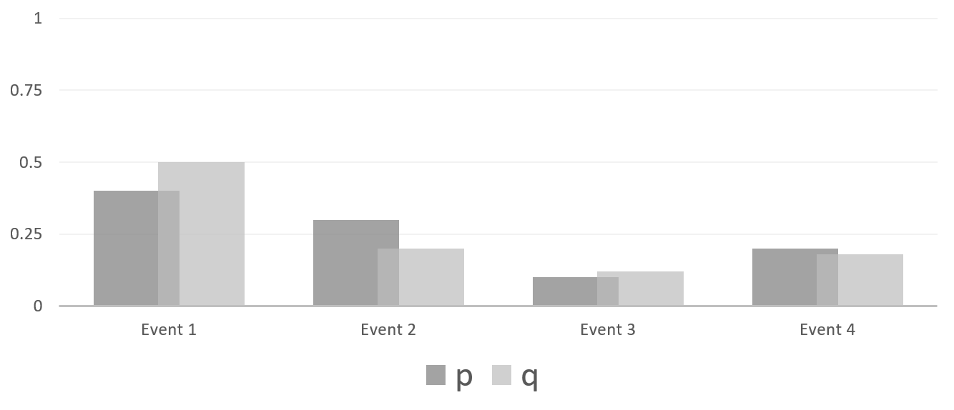
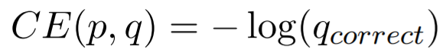
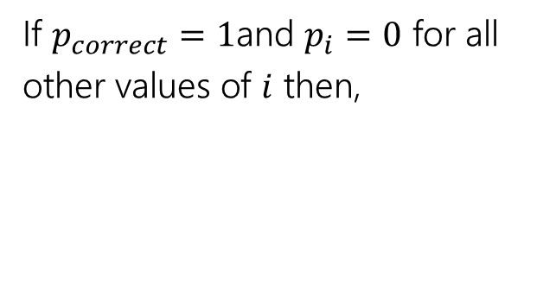
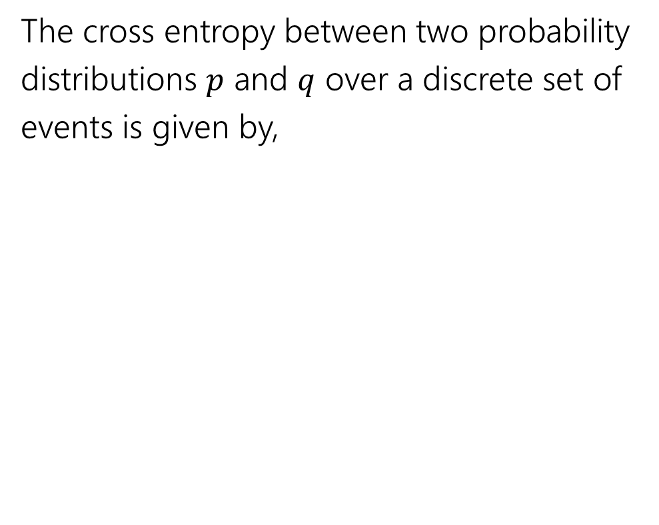
Cross entropy
The cross entropy between two probability distributions $p$ and $q$ over a discrete set of events is given by,
If $p_{correct}=1$and $p_{i}=0$ for all other values of $i$ then,

Slide 14
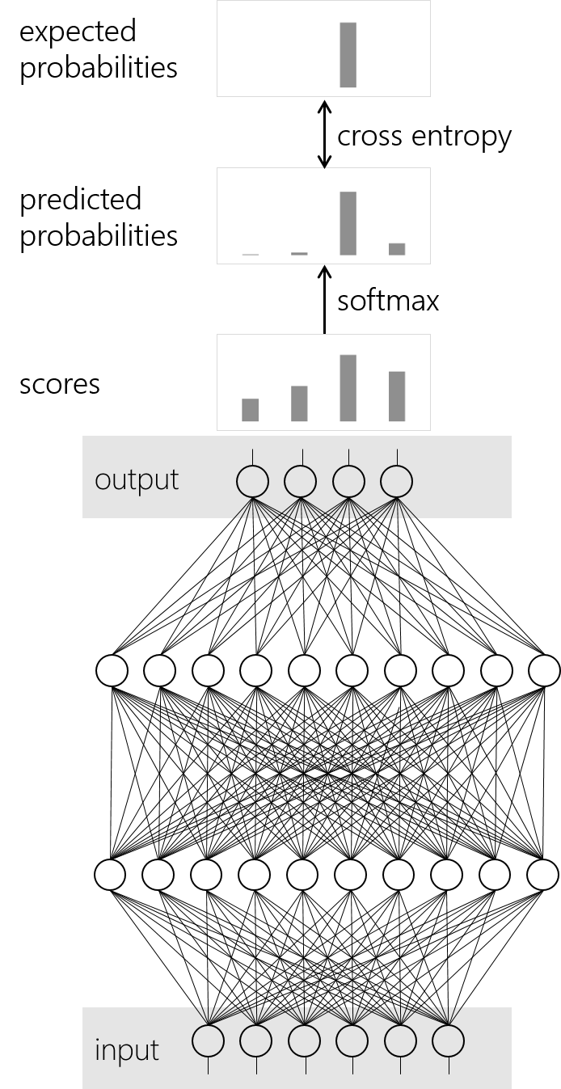
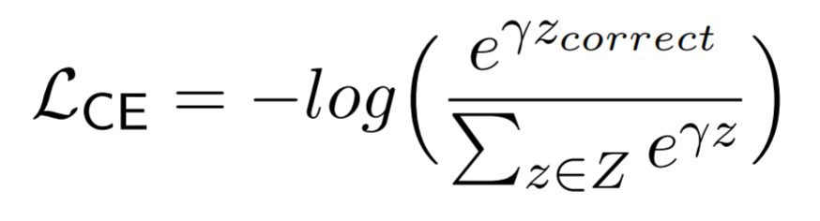
Cross entropy with softmax loss
Cross entropy with softmax is a popular loss function for classification

Slide 15
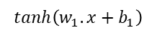
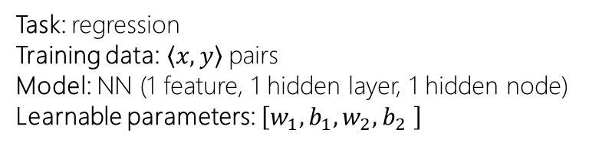
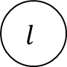
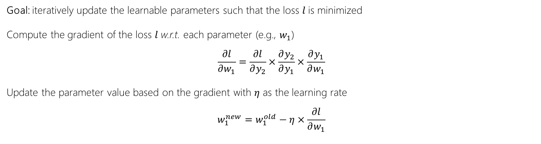
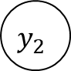
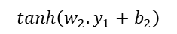
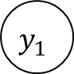
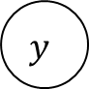
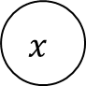
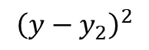
Stochastic Gradient Descent (SGD)
$$x$$
$$tanh\left(w_{1}.x+b_{1}\right)$$
$$y_{1}$$
$$tanh\left(w_{2}.y_{1}+b_{2}\right)$$
$$y_{2}$$
Task: regression
Training data:$\left\langle x,y\right\rangle$ pairs
Model: NN (1 feature, 1 hidden layer, 1 hidden node)
Learnable parameters: $\left[w_{1},b_{1},w_{2},b_{2} \right]$
$${\left(y−y_{2}\right)}^{2}$$
$$l$$
$$y$$
Goal: iteratively update the learnable parameters such that the loss $l$is minimized
Compute the gradient of the loss $l$w.r.t. each parameter (e.g., $w_{1}$)
$$\frac{∂l}{∂w_{1}}=\frac{∂l}{∂y_{2}}×\frac{∂y_{2}}{∂y_{1}}×\frac{∂y_{1}}{∂w_{1}}$$
Update the parameter value based on the gradient with $η$ as the learning rate
$$w_{1}^{new}=w_{1}^{old}−η×\frac{∂l}{∂w_{1}}$$
…and repeat

Slide 16
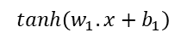
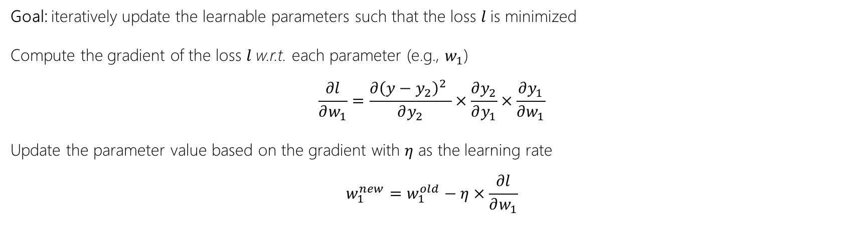
Stochastic Gradient Descent (SGD)
$$x$$
$$tanh\left(w_{1}.x+b_{1}\right)$$
$$y_{1}$$
$$tanh\left(w_{2}.y_{1}+b_{2}\right)$$
$$y_{2}$$
Task: regression
Training data:$\left\langle x,y\right\rangle$ pairs
Model: NN (1 feature, 1 hidden layer, 1 hidden node)
Learnable parameters: $\left[w_{1},b_{1},w_{2},b_{2} \right]$
$${\left(y−y_{2}\right)}^{2}$$
$$l$$
$$y$$
Goal: iteratively update the learnable parameters such that the loss $l$is minimized
Compute the gradient of the loss $l$w.r.t. each parameter (e.g., $w_{1}$)
$$\frac{∂l}{∂w_{1}}=\frac{∂{\left(y−y_{2}\right)}^{2} }{∂y_{2}}×\frac{∂y_{2}}{∂y_{1}}×\frac{∂y_{1}}{∂w_{1}}$$
Update the parameter value based on the gradient with $η$ as the learning rate
$$w_{1}^{new}=w_{1}^{old}−η×\frac{∂l}{∂w_{1}}$$
…and repeat

Slide 17
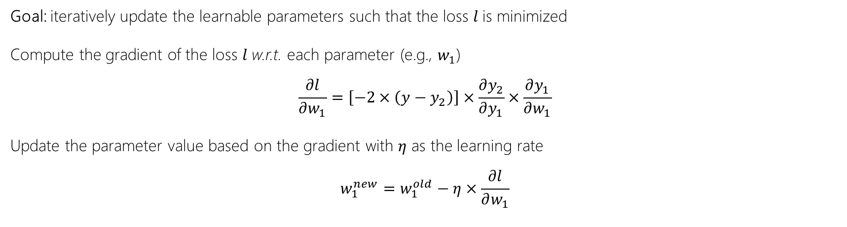
Stochastic Gradient Descent (SGD)
$$x$$
$$tanh\left(w_{1}.x+b_{1}\right)$$
$$y_{1}$$
$$tanh\left(w_{2}.y_{1}+b_{2}\right)$$
$$y_{2}$$
Task: regression
Training data:$\left\langle x,y\right\rangle$ pairs
Model: NN (1 feature, 1 hidden layer, 1 hidden node)
Learnable parameters: $\left[w_{1},b_{1},w_{2},b_{2} \right]$
$${\left(y−y_{2}\right)}^{2}$$
$$l$$
$$y$$
Goal: iteratively update the learnable parameters such that the loss $l$is minimized
Compute the gradient of the loss $l$w.r.t. each parameter (e.g., $w_{1}$)
$$\frac{∂l}{∂w_{1}}=\left[−2×\left(y−y_{2}\right)\right]×\frac{∂y_{2}}{∂y_{1}}×\frac{∂y_{1}}{∂w_{1}}$$
Update the parameter value based on the gradient with $η$ as the learning rate
$$w_{1}^{new}=w_{1}^{old}−η×\frac{∂l}{∂w_{1}}$$
…and repeat

Slide 18
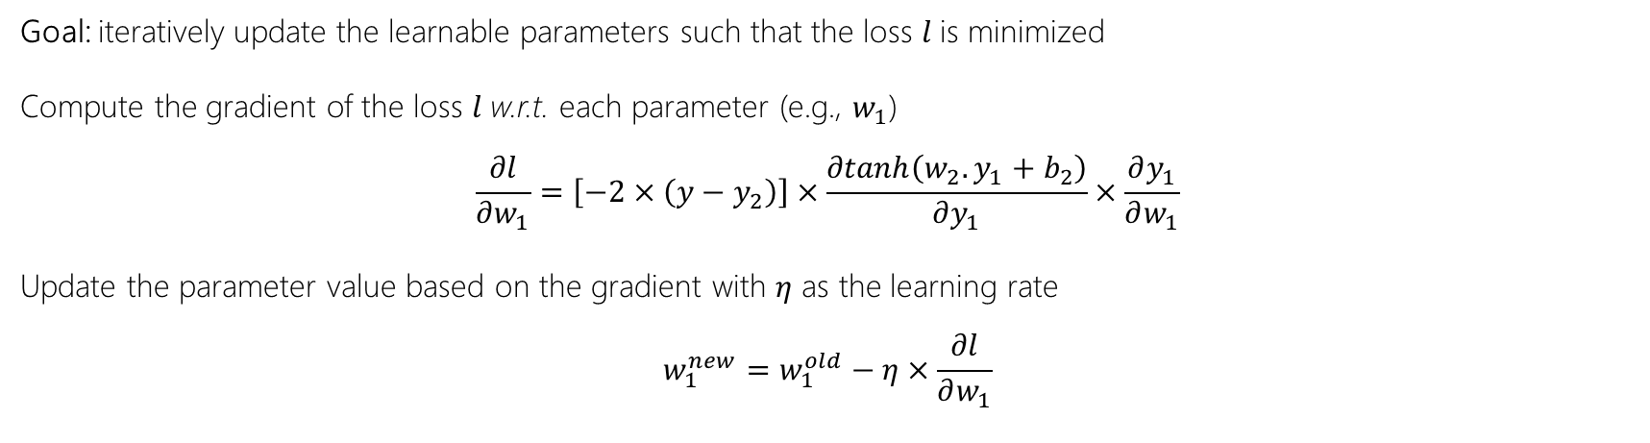
Stochastic Gradient Descent (SGD)
$$x$$
$$tanh\left(w_{1}.x+b_{1}\right)$$
$$y_{1}$$
$$tanh\left(w_{2}.y_{1}+b_{2}\right)$$
$$y_{2}$$
Task: regression
Training data:$\left\langle x,y\right\rangle$ pairs
Model: NN (1 feature, 1 hidden layer, 1 hidden node)
Learnable parameters: $\left[w_{1},b_{1},w_{2},b_{2} \right]$
$${\left(y−y_{2}\right)}^{2}$$
$$l$$
$$y$$
Goal: iteratively update the learnable parameters such that the loss $l$is minimized
Compute the gradient of the loss $l$w.r.t. each parameter (e.g., $w_{1}$)
$$\frac{∂l}{∂w_{1}}=\left[−2×\left(y−y_{2}\right)\right]×\frac{∂tanh\left(w_{2}.y_{1}+b_{2}\right)}{∂y_{1}}×\frac{∂y_{1}}{∂w_{1}}$$
Update the parameter value based on the gradient with $η$ as the learning rate
$$w_{1}^{new}=w_{1}^{old}−η×\frac{∂l}{∂w_{1}}$$
…and repeat

Slide 19
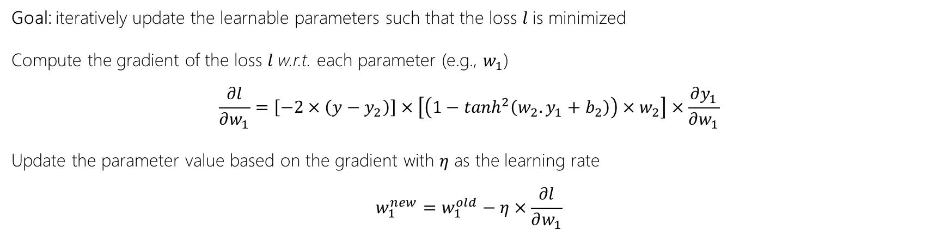
Stochastic Gradient Descent (SGD)
$$x$$
$$tanh\left(w_{1}.x+b_{1}\right)$$
$$y_{1}$$
$$tanh\left(w_{2}.y_{1}+b_{2}\right)$$
$$y_{2}$$
Task: regression
Training data:$\left\langle x,y\right\rangle$ pairs
Model: NN (1 feature, 1 hidden layer, 1 hidden node)
Learnable parameters: $\left[w_{1},b_{1},w_{2},b_{2} \right]$
$${\left(y−y_{2}\right)}^{2}$$
$$l$$
$$y$$
Goal: iteratively update the learnable parameters such that the loss $l$is minimized
Compute the gradient of the loss $l$w.r.t. each parameter (e.g., $w_{1}$)
$$\frac{∂l}{∂w_{1}}=\left[−2×\left(y−y_{2}\right)\right]×\left[\left(1−\tanh^{2}\left(w_{2}.y_{1}+b_{2}\right)\right){×w}_{2}\right]×\frac{∂y_{1}}{∂w_{1}}$$
Update the parameter value based on the gradient with $η$ as the learning rate
$$w_{1}^{new}=w_{1}^{old}−η×\frac{∂l}{∂w_{1}}$$
…and repeat

Slide 20
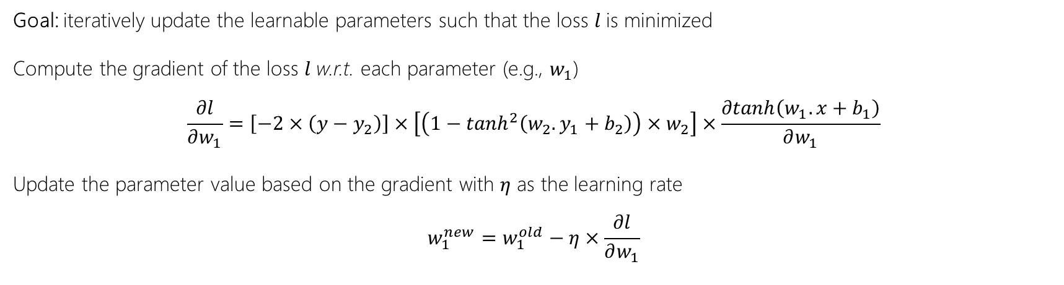
Stochastic Gradient Descent (SGD)
$$x$$
$$tanh\left(w_{1}.x+b_{1}\right)$$
$$y_{1}$$
$$tanh\left(w_{2}.y_{1}+b_{2}\right)$$
$$y_{2}$$
Task: regression
Training data:$\left\langle x,y\right\rangle$ pairs
Model: NN (1 feature, 1 hidden layer, 1 hidden node)
Learnable parameters: $\left[w_{1},b_{1},w_{2},b_{2} \right]$
$${\left(y−y_{2}\right)}^{2}$$
$$l$$
$$y$$
Goal: iteratively update the learnable parameters such that the loss $l$is minimized
Compute the gradient of the loss $l$w.r.t. each parameter (e.g., $w_{1}$)
$$\frac{∂l}{∂w_{1}}=\left[−2×\left(y−y_{2}\right)\right]×\left[\left(1−\tanh^{2}\left(w_{2}.y_{1}+b_{2}\right)\right){×w}_{2}\right]×\frac{∂tanh\left(w_{1}.x+b_{1}\right)}{∂w_{1}}$$
Update the parameter value based on the gradient with $η$ as the learning rate
$$w_{1}^{new}=w_{1}^{old}−η×\frac{∂l}{∂w_{1}}$$
…and repeat

Slide 21
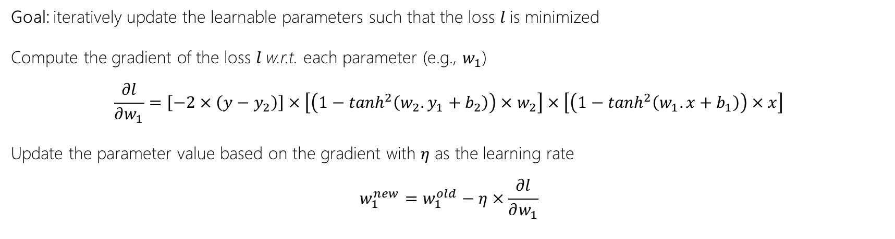
Stochastic Gradient Descent (SGD)
$$x$$
$$tanh\left(w_{1}.x+b_{1}\right)$$
$$y_{1}$$
$$tanh\left(w_{2}.y_{1}+b_{2}\right)$$
$$y_{2}$$
Task: regression
Training data:$\left\langle x,y\right\rangle$ pairs
Model: NN (1 feature, 1 hidden layer, 1 hidden node)
Learnable parameters: $\left[w_{1},b_{1},w_{2},b_{2} \right]$
$${\left(y−y_{2}\right)}^{2}$$
$$l$$
$$y$$
Goal: iteratively update the learnable parameters such that the loss $l$is minimized
Compute the gradient of the loss $l$w.r.t. each parameter (e.g., $w_{1}$)
$$\frac{∂l}{∂w_{1}}=\left[−2×\left(y−y_{2}\right)\right]×\left[\left(1−\tanh^{2}\left(w_{2}.y_{1}+b_{2}\right)\right){×w}_{2}\right]×\left[\left(1−\tanh^{2}\left(w_{1}.x+b_{1}\right)\right)×x\right]$$
Update the parameter value based on the gradient with $η$ as the learning rate
$$w_{1}^{new}=w_{1}^{old}−η×\frac{∂l}{∂w_{1}}$$
…and repeat

Slide 22
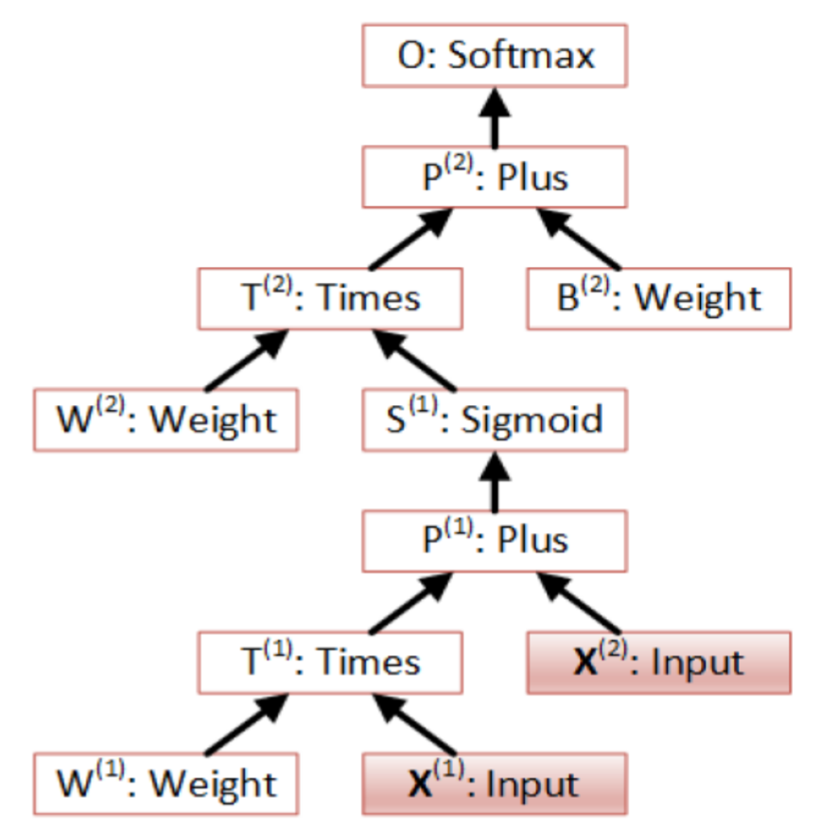
Computation Networks
The “Lego” approach to specifying neural architectures
Library of neural layers, each layer defines logic for:
Forward pass: compute layer output given layer input
Backward pass:
compute gradient of layer output w.r.t. layer inputs
compute gradient of layer output w.r.t. layer parameters (if any)
Chain nodes to create bigger and more complex networks

Slide 23
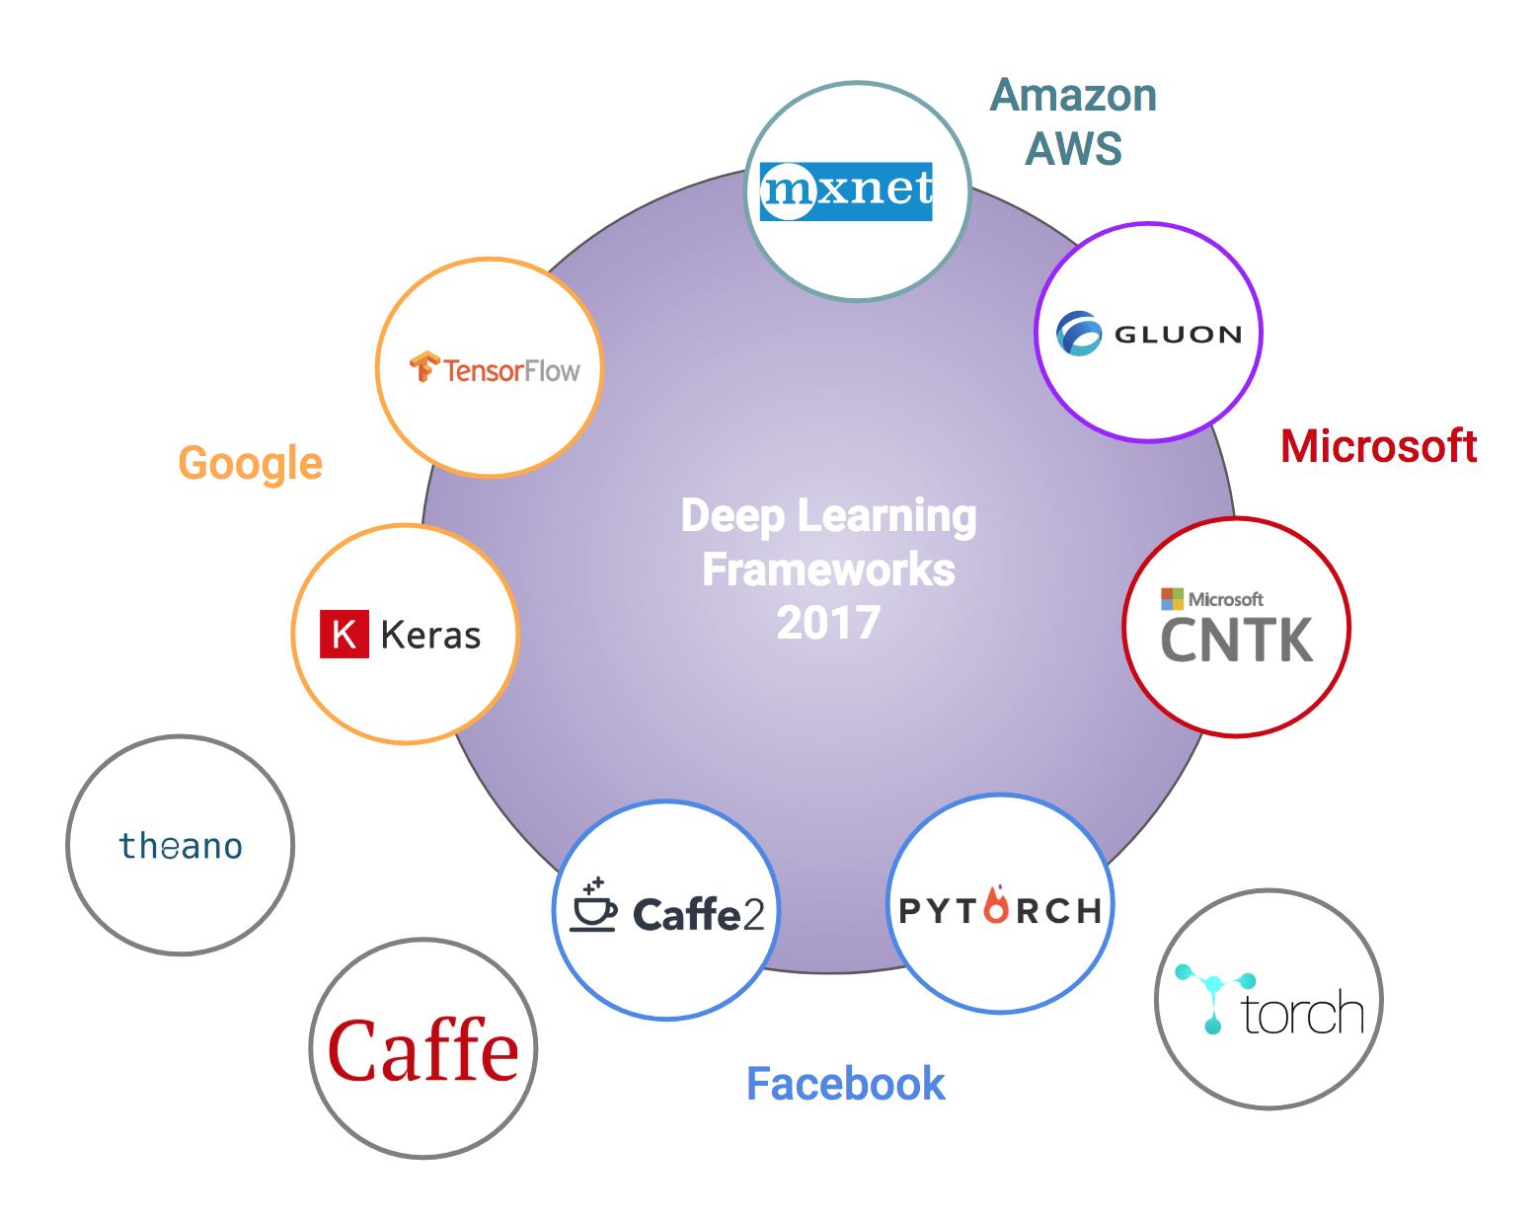
Toolkits
A diverse set of options to choose from!
Figure from https://towardsdatascience.com/battle-of-the-deep-learning-frameworks-part-i-cff0e3841750

Slide 24
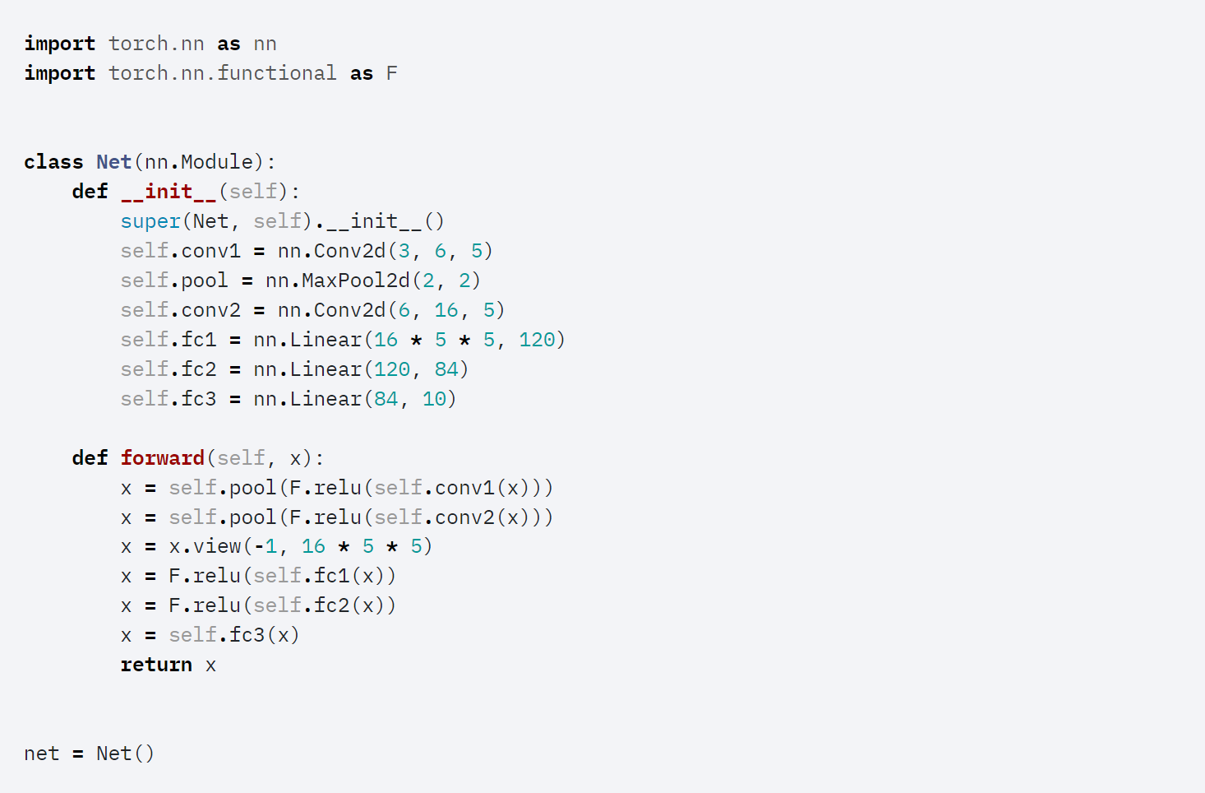
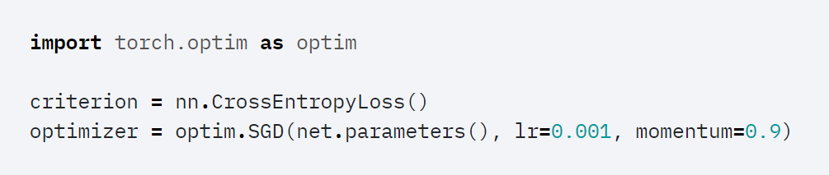
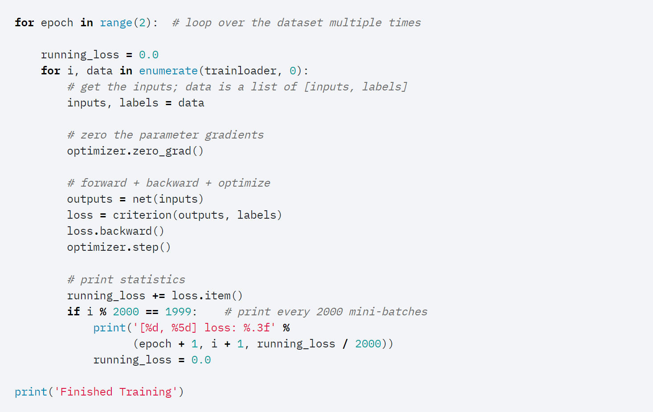
Training a simple image classifier w/ pytorch
First, we define the model architecture
Next, we specify loss function and optimization algorithm
Finally, loop over training data to optimize model parameters
https://pytorch.org/tutorials/beginner/blitz/cifar10_tutorial.html#sphx-glr-beginner-blitz-cifar10-tutorial-py

Slide 25
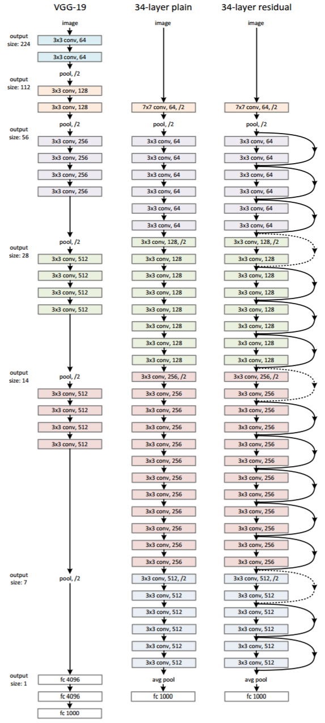
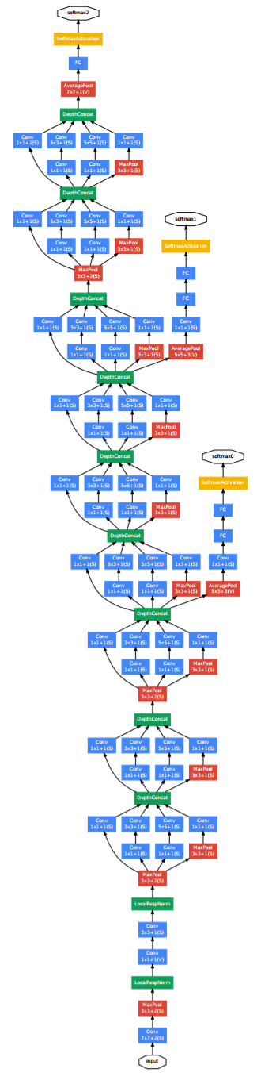
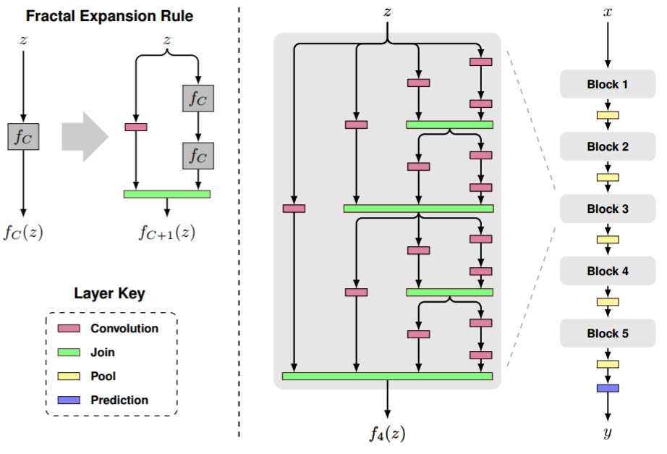
Really Deep Neural Networks
(Larsson et al., 2016)
(He et al., 2015)
(Szegedy et al., 2014)

Slide 26
Visual motivation for hidden layers
Input features |  |  |  | Label
surface | kerberos | book | library
1 | 0 | 1 | 0 | ✓
1 | 1 | 0 | 0 | ✗
0 | 1 | 0 | 1 | ✓
0 | 0 | 1 | 1 | ✗
Consider the following “toy” challenge for classifying tech queries:
Vocab: {surface, kerberos, book, library}
Labels:
“surface book”, “kerberos library” ✓
“kerberos surface”, “library book” ✗
can’t separate using a linear model!
+1
+1
H₁
H₂
But let’s consider a tiny neural network with one hidden layer…
-1
-1
+0.5
+0.5
-1
-1
+0.5
+0.5
surface
library
book
kerberos

Slide 27
Visual motivation for hidden layers
Or more succinctly…
Input features |  |  |  | Hidden layer |  | Label
surface | kerberos | book | library | H₁ | H₂
1 | 0 | 1 | 0 | 1 | 0 | ✓
1 | 1 | 0 | 0 | 0 | 0 | ✗
0 | 1 | 0 | 1 | 0 | 1 | ✓
0 | 0 | 1 | 1 | 0 | 0 | ✗
Consider the following “toy” challenge for classifying tech queries:
Vocab: {surface, kerberos, book, library}
Labels:
“surface book”, “kerberos library” ✓
“kerberos surface”, “library book” ✗
can separate using a linear model!
+1
+1
H₁
H₂
But let’s consider a tiny neural network with one hidden layer…
-1
-1
+0.5
+0.5
-1
-1
+0.5
+0.5
surface
library
book
kerberos

Slide 28
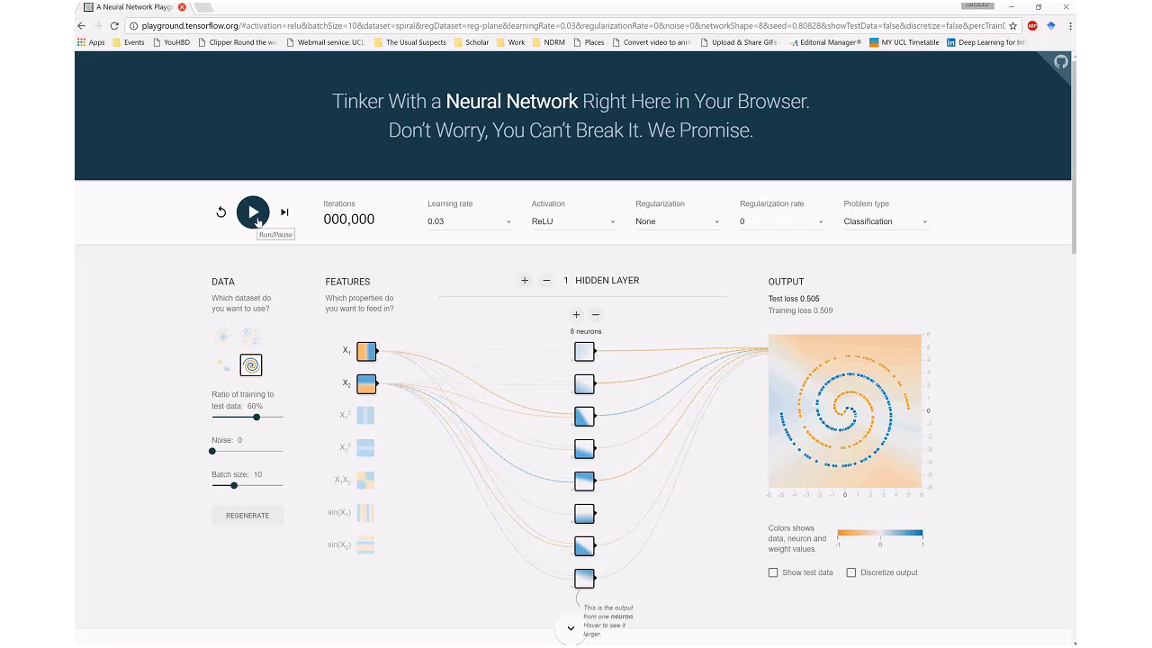
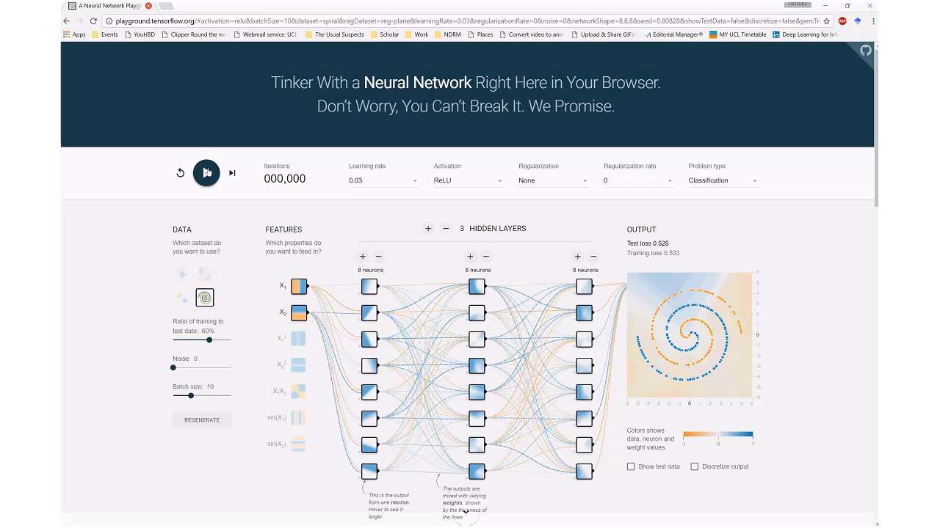
Why adding depth helps
http://playground.tensorflow.org

Slide 29

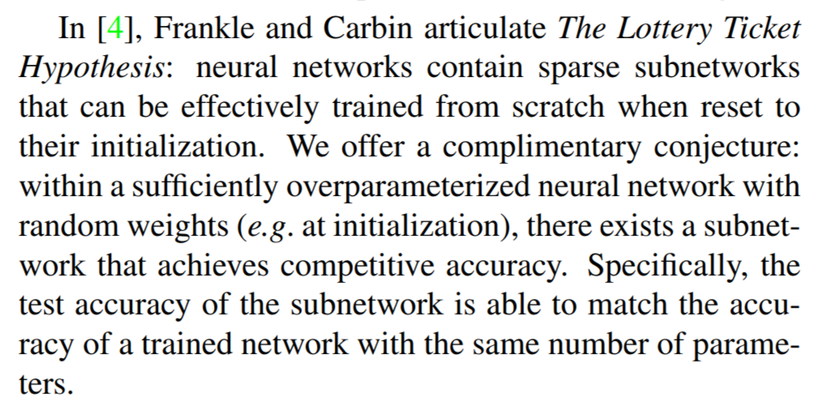

The lottery ticket hypothesis
Jonathan Frankle and Michael Carbin. The lottery ticket hypothesis: Finding sparse, trainable neural networks. In ICLR, 2019.
Vivek Ramanujan, Mitchell Wortsman, Aniruddha Kembhavi, Ali Farhadi, and Mohammad Rastegari. What's Hidden in a Randomly Weighted Neural Network? In ArXiv, 2019.

Slide 30


Bias-Variance trade-off
https://medium.com/@akgone38/what-the-heck-bias-variance-tradeoff-is-fe4681c0e71b

Slide 31



x = 20 samples in range [0-10)
array([0.90958323, 1.92243063, 2.08584585, 2.20797776, 2.67748774, 2.74804427, 3.30582528, 4.61371217, 4.82180332, 5.05056425, 5.17943809, 5.24673789, 5.25498203, 6.51998081, 6.69507593, 7.41185813, 8.30728588, 8.49480071, 8.51663415, 9.65215509])
y = x**2 + noise
array([-6.98410155, -2.72058483, 1.83675969, 7.01024352, 8.57596003, 4.33476856, 18.5227248 , 23.40644589, 24.19983813, 20.17728703, 21.67505609, 28.50143303, 39.2529178 , 38.61850753, 50.06987467, 54.84458601, 75.04156323, 64.05990929, 69.81111628, 93.59637334])

Slide 32


Slide 33


Slide 34

Bias-variance trade-off in the deep learning era
Mikhail Belkin, Daniel Hsu, Siyuan Ma, and Soumik Mandal. Reconciling modern machine-learning practice and the classical bias–variance trade-off. In PNAS, 2019.

Slide 35





Most ir systems present ranked lists of retrieved information artifacts

Slide 36



THE UNREASONABLE EFFECTIVENESS OF SIMPLE LTR BASED APPROACHES

Slide 37

Learning to Rank (LTR)
”... the task to automatically construct a ranking model using training data, such that the model can sort new objects according to their degrees of relevance, preference, or importance.”
- Liu [2009]
Phase 1
Phase 2
Tie-Yan Liu. Learning to rank for information retrieval. Foundation and Trends in Information Retrieval, 2009.
Image source: https://storage.googleapis.com/pub-tools-public-publication-data/pdf/45530.pdf

Slide 38

Learning to Rank (LTR)
L2R models represent a rankable item—e.g., a document—given some context—e.g., a user-issued query—as a numerical vector $\vec{x}∈ℝ^{n}$
The ranking model $f:\vec{x}→ℝ$ is trained to map the vector to a real-valued score such that relevant items are scored higher.
Phase 1
Phase 2
Tie-Yan Liu. Learning to rank for information retrieval. Foundation and Trends in Information Retrieval, 2009.
Image source: https://storage.googleapis.com/pub-tools-public-publication-data/pdf/45530.pdf

Slide 39
Why is ranking challenging?
Ideally: Train a machine learning model to optimize for a rank based metric
Challenge: Rank based metrics, such as DCG or MRR, are non-smooth / non-differentiable

Slide 40




Why is ranking challenging?
Examples of ranking metrics
Discounted Cumulative Gain (DCG)
$$DCG@k=\sum_{i=1}^{k}{\frac{2^{{rel}_{i}^{}}−1}{\log_{2}\left(i+1\right)}}$$
Reciprocal Rank (RR)
$$RR@k=\max_{1<i<k}{\frac{{rel}_{i}}{i}}$$
Rank based metrics, such as DCG and MRR, are non-smooth / non-differentiable

Slide 41
Features
They can often be categorized as:
Query-independent or static features
e.g., incoming link count and document length
Query-dependent or dynamic features
e.g., BM25
Query-level features
e.g., query length
Traditional L2R models employ hand-crafted features that encode IR insights

Slide 42


Features
Tao Qin, Tie-Yan Liu, Jun Xu, and Hang Li. LETOR: A Benchmark Collection for Research on Learning to Rank for Information Retrieval, Information Retrieval Journal, 2010

Slide 43

Approaches
Pointwise approach
Relevance label $y_{q,d}$ is a number—derived from binary or graded human judgments or implicit user feedback (e.g., CTR). Typically, a regression or classification model is trained to predict $y_{q,d}$ given ${\vec{x}}_{q,d}$.
Pairwise approach
Pairwise preference between documents for a query ($d_{i}≻d_{j}$ w.r.t. $q$) as label. Reduces to binary classification to predict more relevant document.
Listwise approach
Directly optimize for rank-based metric, such as NDCG—difficult because these metrics are often not differentiable w.r.t. model parameters.
Liu [2009] categorizes different LTR approaches based on training objectives:
Tie-Yan Liu. Learning to rank for information retrieval. Foundation and Trends in Information Retrieval, 2009.

Slide 44


Pointwise objectives
labels
Regression loss
Given $\left\langle q,d\right\rangle$ predict the value of $y_{q,d}$
e.g., square loss for binary or categorical labels,
where, $y_{q,d}$ is the one-hot representation [Fuhr, 1989] or the actual value [Cossock and Zhang, 2006] of the label
prediction
Norbert Fuhr. Optimum polynomial retrieval functions based on the probability ranking principle. ACM TOIS, 1989.
David Cossock and Tong Zhang. Subset ranking using regression. In COLT, 2006.

Slide 45


Pointwise objectives
0
1
labels
Classification loss
Given $\left\langle q,d\right\rangle$ predict the class $y_{q,d}$
e.g., cross-entropy with softmax over categorical labels $Y$ [Li et al., 2008],
where, $s_{y_{q,d}}$ is the model’s score for label $y_{q,d}$
prediction
Ping Li, Qiang Wu, and Christopher J Burges. Mcrank: Learning to rank using multiple classification and gradient boosting. In NIPS, 2008.

Slide 46



Pairwise objectives
Pairwise loss generally has the following form [Chen et al., 2009],
where, $φ$ can be,
Hinge function $φ\left(z\right)=max\left(0, 1−z\right)$ [Herbrich et al., 2000]
Exponential function $φ\left(z\right)=e^{−z}$ [Freund et al., 2003]
Logistic function $φ\left(z\right)=log\left(1+e^{−z}\right)$ [Burges et al., 2005]
Others…
Pairwise loss minimizes the average number of inversions in ranking—i.e., $d_{i}≻d_{j}$ w.r.t. $q$but $d_{j}$ is ranked higher than $d_{i}$
Given $\left\langle q,d_{i},d_{j}\right\rangle$, predict the more relevant document
For $\left\langle q,d_{i} \right\rangle$ and $\left\langle q, d_{j}\right\rangle$,
Feature vectors: ${\vec{x}}_{i}$ and ${\vec{x}}_{j}$
Model scores: $s_{i}=f\left({\vec{x}}_{i}\right)$ and $s_{j}=f\left({\vec{x}}_{j}\right)$
Wei Chen, Tie-Yan Liu, Yanyan Lan, Zhi-Ming Ma, and Hang Li. Ranking measures and loss functions in learning to rank. In NIPS, 2009.
Ralf Herbrich, Thore Graepel, and Klaus Obermayer. Large margin rank boundaries for ordinal regression. 2000.
Yoav Freund, Raj Iyer, Robert E Schapire, and Yoram Singer. An efficient boosting algorithm for combining preferences. In JMLR, 2003.
Chris Burges, Tal Shaked, Erin Renshaw, Ari Lazier, Matt Deeds, Nicole Hamilton, and Greg Hullender. Learning to rank using gradient descent. In ICML, 2005.

Slide 47

Pairwise objectives
0
1
pairwise preference
RankNet loss
Pairwise loss function proposed by Burges et al. [2005]—an industry favourite [Burges, 2015]
Predicted probabilities: $p_{ij}=p\left(s_{i}>s_{j}\right)≡\frac{e^{γ.s_{i}^{}}}{e^{γ.s_{i}^{}}+e^{γ.s_{j}^{}}}=\frac{1}{1+e^{−γ.\left(s_{i}−s_{j}\right) }}$
Desired probabilities: ${\overline{p}}_{ij}=1$ and ${\overline{p}}_{ji}=0$
Computing cross-entropy between $p$ and $\overline{p}$
$$ℒ_{RankNet}=−{\overline{p}}_{ij}.log\left(p_{ij}\right)−{\overline{p}}_{ji}.log\left(p_{ji}\right)=−log\left(p_{ij}\right)=log\left(1+e^{−γ.\left(s_{i}−s_{j}\right) }\right)$$
score
Chris Burges, Tal Shaked, Erin Renshaw, Ari Lazier, Matt Deeds, Nicole Hamilton, and Greg Hullender. Learning to rank using gradient descent. In ICML, 2005.
Chris Burges. RankNet: A ranking retrospective. https://www.microsoft.com/en-us/research/blog/ranknet-a-ranking-retrospective/. 2015.

Slide 48

A generalized cross-entropy loss
An alternative loss function assumes a single relevant document $d^{+}$ and compares it against the full collection $D$
Predicted probabilities: $p\left(d^{+}|q\right)=\frac{e^{γ.s\left(q,d^{+}\right) }}{\sum_{d∈D}{e^{γ.s\left(q,d \right) }}}$
The cross-entropy loss is then given by,
$$ℒ_{CE}\left(q,d^{+},D\right)=−log\left(p\left(d^{+}|q\right)\right)=−log\left(\frac{e^{γ.s\left(q,d^{+}\right) }}{\sum_{d∈D}{e^{γ.s\left(q,d \right) }}}\right)$$
Computing the softmax over the full collection is prohibitively expensive—LTR models typically consider few negative candidates [Huang et al., 2013, Shen et al., 2014, Mitra et al., 2017]
Po-Sen Huang, Xiaodong He, Jianfeng Gao, Li Deng, Alex Acero, and Larry Heck. Learning deep structured semantic models for web search using clickthrough data. In CIKM, 2013.
Yelong Shen, Xiaodong He, Jianfeng Gao, Li Deng, and Gregoire Mesnil. A latent semantic model with convolutional-pooling structure for information retrieval. In CIKM, 2014.
Bhaskar Mitra, Fernando Diaz, and Nick Craswell. Learning to match using local and distributed representations of text for web search. In WWW, 2017.

Slide 49

Listwise objectives
Blue: relevant Gray: non-relevant
NDCG and ERR higher for left but pairwise errors less for right
Due to strong position-based discounting in IR measures, errors at higher ranks are much more problematic than at lower ranks
But listwise metrics are non-continuous and non-differentiable
[Burges, 2010]
Christopher JC Burges. From ranknet to lambdarank to lambdamart: An overview. Learning, 2010.

Slide 50

Listwise objectives
Burges et al. [2006] make two observations:
To train a model we don’t need the costs themselves, only the gradients (of the costs w.r.t model scores)
It is desired that the gradient be bigger for pairs of documents that produces a bigger impact in NDCG by swapping positions
LambdaRank loss
Multiply actual gradients with the change in NDCG by swapping the rank positions of the two documents
Christopher JC Burges, Robert Ragno, and Quoc Viet Le. Learning to rank with nonsmooth cost functions. In NIPS, 2006.

Slide 51

Listwise objectives
ListNet loss
Cao et al. [2007] propose to compute the probability distribution over all possible permutations based on model score and ground-truth labels. The loss is then given by the K-L divergence between these two distributions.
This is computationally very costly, computing permutations of only the top-K items makes it slightly less prohibitive.
ListMLE loss
Xia et al. [2008] propose to compute the probability of the ideal permutation based on the ground truth. However, with categorical labels more than one permutation is possible.
According to the Placket Luce model [Luce, 2005], given four items $\left\{d_{1},d_{2},d_{3},d_{4}\right\}$ the probability of observing a particular rank-order, say $\left[d_{2},d_{1},d_{4},d_{3}\right]$, is given by:
where, $π$ is a particular permutation and $φ$ is a transformation (e.g., linear, exponential, or sigmoid) over the score $s_{i}$ corresponding to item $d_{i}$
R Duncan Luce. Individual choice behavior. 1959.
Zhe Cao, Tao Qin, Tie-Yan Liu, Ming-Feng Tsai, and Hang Li. Learning to rank: from pairwise approach to listwise approach. In ICML, 2007.
Fen Xia, Tie-Yan Liu, Jue Wang, Wensheng Zhang, and Hang Li. Listwise approach to learning to rank: theory and algorithm. In ICML, 2008.

Slide 52


Listwise objectives
Smooth DCG
Wu et al. [2009] compute a “smooth” rank of documents as a function of their scores
This “smooth” rank can be plugged into a ranking metric, such as MRR or DCG, to produce a smooth ranking loss
Mingrui Wu, Yi Chang, Zhaohui Zheng, and Hongyuan Zha. Smoothing DCG for learning to rank: A novel approach using smoothed hinge functions. In CIKM, 2009.

Slide 53
Deep learning to rank
60 mins

Slide 54




The state of neural information retrieval
Growing publication popularity at top IR conferences
Strong performance against traditional methods in TREC 2019

Slide 55

latent representation Learning for text
albuquerque
Passage about Albuquerque
Passage not about Albuquerque
Inspecting non-query terms in the document may reveal important clues about whether the document is relevant to the query

Slide 56

Deep Structured Semantic Model
Learn latent dense vector representation of query and document text
Relevance is estimated by cosine similarity between query and document embeddings
Relevant document embeddings should be more similar to query embeddings than non-relevant document embeddings
Po-Sen Huang, Xiaodong He, Jianfeng Gao, Li Deng, Alex Acero, and Larry Heck. Learning deep structured semantic models for web search using clickthrough data. In CIKM, 2013.

Slide 57
But how can we input text into a neural model?

Slide 58

Different modalities of input text representation

Slide 59
Different modalities of input text representation

Slide 60
Different modalities of input text representation

Slide 61
Different modalities of input text representation

Slide 62

Deep Structured Semantic Model
To train the model we can use any of the loss functions we learned about in the last lecture
Cross-entropy loss against randomly sampled negative documents is commonly used
Po-Sen Huang, Xiaodong He, Jianfeng Gao, Li Deng, Alex Acero, and Larry Heck. Learning deep structured semantic models for web search using clickthrough data. In CIKM, 2013.

Slide 63

Shift-invariant neural operations
Detecting a pattern in one part of the input space is similar to detecting it in another
Leverage redundancy by moving a window over the whole input space and then aggregate
On each instance of the window a kernel—also known as a filter or a cell—is applied
Different aggregation strategies lead to different architectures

Slide 64


Convolution
Move the window over the input space each time applying the same cell over the window
A typical cell operation can be,
$$h=σ\left(WX+b\right)$$
Full Input | [words x in_channels]
Cell Input | [window x in_channels]
Cell Output | [1 x out_channels]
Full Output | [1 + (words – window) / stride x out_channels]

Slide 65

Pooling
Move the window over the input space each time applying an aggregate function over each dimension in within the window
$$h_{j}=\max_{i∈win}\left(X_{i,j}\right) or h_{j}={avg}_{i∈win}\left(X_{i,j}\right)$$
max -pooling
average -pooling
Full Input | [words x channels]
Cell Input | [window x channels]
Cell Output | [1 x channels]
Full Output | [1 + (words – window) / stride x channels]

Slide 66

Convolution w/ Global Pooling
Stacking a global pooling layer on top of a convolutional layer is a common strategy for generating a fixed length embedding for a variable length text
Full Input | [words x in_channels]
Full Output | [1 x out_channels]

Slide 67


Recurrence
Similar to a convolution layer but additional dependency on previous hidden state
A simple cell operation shown below but others like LSTM and GRUs are more popular in practice,
$$h_{i}=σ\left(WX_{i}+Uh_{i−1}+b\right)$$
Full Input | [words x in_channels]
Cell Input | [window x in_channels] + [1 x out_channels]
Cell Output | [1 x out_channels]
Full Output | [1 x out_channels]

Slide 68


Convolutional DSSM (CDSSM)
Replace bag-of-words assumption by concatenating term vectors in a sequence on the input
Convolution followed by global max-pooling
Yelong Shen, Xiaodong He, Jianfeng Gao, Li Deng, and Gregoire Mesnil. A latent semantic model with convolutional-pooling structure for information retrieval. In CIKM, 2014.

Slide 69


Interaction-based networks
Typically a document is relevant if some part of the document contains information relevant to the query
Interaction matrix $X$—where $x_{ij}$ is obtained by comparing the i^{th} window over query terms with the j^{th} window over the document terms—captures evidence of relevance from different parts of the document
Additional neural network layers can inspect the interaction matrix and aggregate the evidence to estimate overall relevance
Zhengdong Lu and Hang Li. A deep architecture for matching short texts. In NIPS, 2013.

Slide 70


Kernel pooling
Chenyan Xiong, Zhuyun Dai, Jamie Callan, Zhiyuan Liu, and Russell Power. End-to-end neural ad-hoc ranking with kernel pooling. In SIGIR, 2017.
Zhuyun Dai, Chenyan Xiong, Jamie Callan, and Zhiyuan Liu. Convolutional neural networks for soft-matching n-grams in ad-hoc search. In WSDM, 2018.

Slide 71

Lexical and semantic matching networks
Mitra et al. [2016] argue that both lexical and semantic matching is important for document ranking
Duet model is a linear combination of two DNNs—focusing on lexical and semantic matching, respectively—jointly trained on labelled data
Bhaskar Mitra, Fernando Diaz, and Nick Craswell. Learning to match using local and distributed representations of text for web search. In WWW, 2017.

Slide 72


Lexical and semantic matching networks
Lexical sub-model operates over input matrix $X$
$$x_{i,j}=\left\{\begin{aligned}1, if t_{q,i}=t_{d,j} \\ 0, otherwise\end{aligned}\right.$$
In relevant documents,
Many matches, typically in clusters
Matches localized early in document
Matches for all query terms
In-order (phrasal) matches
Bhaskar Mitra, Fernando Diaz, and Nick Craswell. Learning to match using local and distributed representations of text for web search. In WWW, 2017.

Slide 73
Duet implementation on PyTorch
https://github.com/bmitra-msft/NDRM/blob/master/notebooks/Duet.ipynb
Get the code

Slide 74













Many other neural architectures
(Hui et al., 2017)
(Pang et al., 2017)
(Denil et al., 2014)
(Severyn and Moschitti, 2015)
(Jaech et al., 2017)
(Kalchbrenner et al., 2014)
(Dehghani et al., 2017)
(Kim, 2014)
(Guo et al., 2016)
(Zhao et al., 2015)
(Palangi et al., 2015)
(Hu et al., 2014)
(Tai et al., 2015)

Slide 75


BERT for Ranking
Impact across both academia and industry

Slide 76


Attention
Given a set of n items and an input context, produce a probability distribution {a₁, …, a_{i}, …, a_{n}} of attending to each item as a function of similarity between a learned representation (q) of the context and learned representations (k_{i}) of the items
$$a_{i}=\frac{φ\left(q, k_{i}\right)}{\sum_{j}^{n}{φ\left(q, k_{j}\right)}}$$
The aggregated output is given by $\sum_{i}^{n}{a_{i}∙v_{i}}$
Full Input | [words x in_channels], [1 x ctx_channels]
Full Output | [1 x out_channels]
* When attending over a sequence (and not a set), the key k and value v are typically a function of the item and some encoding of the position

Slide 77

Self attention
Given a sequence (or set) of n items, treat each item as the context at a time and attend over the whole sequence (or set), and repeat for all n items
Full Input | [words x in_channels]
Full Output | [words x out_channels]

Slide 78

Self attention
Given a sequence (or set) of n items, treat each item as the context at a time and attend over the whole sequence (or set), and repeat for all n items
Full Input | [words x in_channels]
Full Output | [words x out_channels]

Slide 79

Self attention
Given a sequence (or set) of n items, treat each item as the context at a time and attend over the whole sequence (or set), and repeat for all n items
Full Input | [words x in_channels]
Full Output | [words x out_channels]

Slide 80

transformers
A transformer layer consists of a combination of self-attention layer and multiple fully-connected or convolutional layers, with residual connections
A transformer-based encoder can consist of multiple transformers stacked in sequence
Full Input | [words x in_channels]
Full Output | [words x out_channels]
Ashish Vaswani, Noam Shazeer, Niki Parmar, Jakob Uszkoreit, Llion Jones, Aidan N. Gomez, Łukasz Kaiser, and Illia Polosukhin. Attention is all you need. In NeurIPS, 2017.

Slide 81
language modeling
w₃
loss
A family of language modeling tasks have been explored in the literature, including:
Predict next word in a sequence
Predict masked word in a sequence
Predict next sentence
Fundamentally the same idea as word2vec and older neural LMs—but with deeper models and considering dependencies across longer distances between terms
?
model
w₁
w₂
[MASK]
w₄

Slide 82


contextualized Deep word embeddings
http://jalammar.github.io/illustrated-bert/
Jacob Devlin, Ming-Wei Chang, et al. Bert: Pre-training of deep bidirectional transformers for language understanding. In NAACL, 2018.
Matthew E. Peters, Mark Neumann, Mohit Iyyer, Matt Gardner, Christopher Clark, Kenton Lee, and Luke Zettlemoyer. Deep contextualized word representations. In NAACL-HLT, 2018.

Slide 83


BERT
Stacked transformer layers
Pretrained on two tasks:
Masked language modeling
Next sentence prediction
Input: WordPiece embedding + position embedding + segment embedding
Jacob Devlin, Ming-Wei Chang, et al. Bert: Pre-training of deep bidirectional transformers for language understanding. In NAACL, 2018.

Slide 84







BERT for Ranking
BERT (and other large-scale unsupervised language models) are demonstrating dramatic performance improvements on many IR tasks
MS MARCO
score
Query
Passage
Query Passage Pair
Rodrigo Nogueira, and Kyunghyun Cho. Passage Re-ranking with BERT. In arXiv, 2019.

Slide 85


Deep Learning @ TREC
If you are looking for interesting research topics at the intersection of machine learning and search, come participate in the track!

Slide 86


Goal: Large, human-labeled, open IR data
Mitra, Diaz and Craswell. Learning to match using local and distributed representations of text for web search.
WWW 2017
Dehghani, Zamani, Severyn, Kamps and Croft. Neural ranking models with weak supervision. SIGIR 2017
TREC 2019 Deep Learning Track
Past: Proprietary data
Past: Weak supervision
Here: Two new datasets
Promising
Promising?
Promising
Better search results
More data
200K queries, human-labeled, proprietary
1+M queries, weak supervision, open
300+K queries, human-labeled, open

Slide 87


Generating public benchmarks for neural IR research
A public retrieval and ranking benchmark with large scale training data (~400K queries with manual relevance labels)

Slide 88


Deriving our TREC 2019 datasets
MS MARCO QnA Leaderboard
1M real queries
MS MARCO Passage Retrieval Leaderboard
Corpus: Union of 10-passage sets
TREC 2019 Task: Passage Retrieval
Same corpus, training Q+labels
New reusable NIST test set
TREC 2019 Task: Document Retrieval
10 passages per Q
Human annotation says ~1 of 10 answers the query
Labels: From the ~1 positive passage
Labels: Transfer from passage to doc
Corpus: Documents (crawl passage urls)
New reusable NIST test set
http://msmarco.org
https://microsoft.github.io/TREC-2019-Deep-Learning/

Slide 89
Setup of the 2019 deep learning track
Task | Training data | Test data | Corpus
1) Document retrieval | 367K queries w/ doc labels | 43* queries w/ doc labels | 3.2M documents
2) Passage retrieval | 502K queries w/ pass labels | 43* queries w/ pass labels | 8.8M passages
Key question: What works best in a large-data regime?
“nnlm”: Runs that use a BERT-style language model
“nn”: Runs that do representation learning
“trad”: Runs using only traditional IR features (such as BM25 and RM3)
Subtasks:
“fullrank”: End-to-end retrieval
“rerank”: Top-k reranking. Doc: k=100 Indri QL. Pass: k=1000 BM25.
* Mostly-overlapping query sets (41 shared)

Slide 90


Dataset availability
Corpus + train + dev data for both tasks available now from the DL Track site*
NIST test sets available to participants now
[Broader availability in Feb 2020]
* https://microsoft.github.io/TREC-2019-Deep-Learning/

Slide 91

Summary of TREC 2019 deep learning track results

Slide 92



Slide 93




Next: Learning to rank Lab sessions @ 1PM
Thank You

